Slide 1
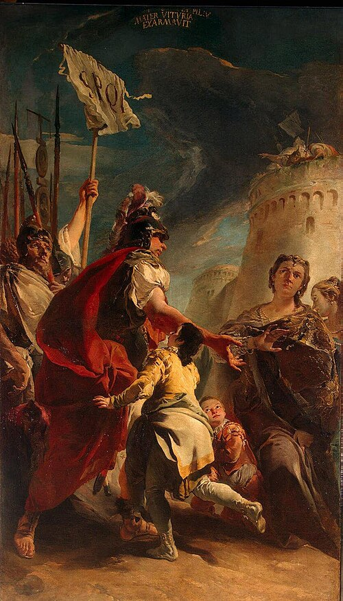
Introduction to Shakespeare: Coriolanus
The Language Fellow

Slide 2
“Shameless self-promotion”
If you need practice questions for UGC-NET, please register on thelanguagefellow.com
Follow us on youtube and instagram

Slide 3
Contents
Ethos, pathos, logos
Coriolanus in today’s terms
Historical context
Shakespeare’s Roman and Greek plays
Summary by act
Summing up

Slide 4
Ethos, Pathos, Logos
Ethos: appeal to authority (I am an expert on the subject)
Pathos: appeal to emotions (these graphics are so aesthetically pleasing)
Logos: appeal to reason (this will teach me how to think)

Slide 5
What’s Coriolanus about: a quotation
Finally I arrived at the conclusion that, making due allowances for the subject itself being rather foreign to women’s normal sensibilities, the lady could not have been an Italian. I wonder whether she was European at all? In any case, no Latin temperament would have perceived anything morbid in the acute consciousness of lost honour. Such a consciousness may be wrong, or it may be right, or it may be condemned as artificial; and, perhaps, my Jim is not a type of wide commonness.

Slide 6
What’s Coriolanus about: dignity and conflict
Ever come across ideas like “Why let these people read Shakespeare? It’s a class apart.”
Stills from Hindi films (left to right from top left):
  Soldier, having mistakenly shot a civilian, goes to apologize to the family of the deceased
  Policemen being told off for raising issues needing urgent attention, an inspector being told he’s being shunted
  Veteran giving evidence that he represented his country and won medals, to no avail
  Veteran telling a journalist to sit on the floor for he is his superior
  Cop requesting his senior to give him a chance to prove his honesty and worth or to suspend him
  Soldier shooting another to ensure that the latter’s killed
  Convict forcing a fresh convict to lick the former’s spit he’s just spat
  Recent news: mention of disrespect of women
  Cop before a scene in which another cop indirectly accuses the former of being a lapdog

Slide 7
Historical Context
Popular uprisings, 1607 grain riots etc.
Change of regime: Elizabeth and James I
James I and the House of Commons
Elizabethan milieu as a melting pot
Thought on rule
Conflict with Spain
Historical plays

Slide 8
Shakespeare’s Roman and Greek Plays
Study of sources, now developed into, e.g., textual criticism
Holinshed (English history)
Plutarch (Roman and Greek history)
His later plays—much difference from his earlier plays
The Greco-Roman in them, e.g., ideas like platonic love, Spartans, stoics etc.

Slide 9
Summary by act: act 1
The people of the town and representatives of the patrician Menenius and Martius (Coriolanus); reform pacifies them—they have a representation in the government
News comes of Volsces preparing to attack Rome—Coriolanus proved right—is ‘constant’ and gets ready to fight Aufidius (the relationship potrayed differently from the source)
Volumnia, Coriolanus’ mother welcomes the glorious chance but his wife is concerned—cf. show of wounds
Martius wins Corioli single-handed and is named after the city, Coriolanus.

Slide 10
Summary by act: act 2
Rome waits for the news of the battle
Coriolanus’ unchanging attitude towards the people does not change and causes anger among them (tribunes representative of the people, newly made)
They plot against Coriolanus; don’t succeed yet; Coriolanus is the choice for consulship
He’s made to canvas support of the people
His attitude towards the people not changing, the hostility continues

Slide 11
Summary by act: act 3
Another contact with the people results in his behavior being interpreted as treason
Attempts at his arrest fail, but he’s made answerable to the charges pressed against him
Volumnia counsels him and he agrees but is provoked into speaking his mind
Consequently, Coriolanus is banished from Rome

Slide 12
Summary by act: act 4
Coriolanus, after being expelled, changes sides and teams up with Aufidius, his enemy preparing to attack Rome, to revenge his insult
There’s temporary peace and prosperity until news arrives
Aufidius plans to double-cross Coriolanus once Rome is won

Slide 13
Summary by act: act 5
Menenius, under pressure, tries to persuade Coriolanus not to attack Rome but fails
Volumnia is made to do the same; she succeeds and this makes Coriolanus vulnerable
Aufidius grabs the opportunity, accuses Coriolanus of treachery and has him assassinated

Slide 14
Summing up
Coriolanus is about class conflict, government, ambition, the individual vs the collective
King James’ rule; contemporary politics is not something Shakespeare comments upon directly—that is seen as an achievement (cf. ethos, pathos and logos; also Ben Jonson was imprisoned etc.)
Coriolanus-Volumnia relationship, the patricians and the masses (cf., e.g., post-Independence India), Coriolanus’ feelings towards the common people, his feelings towards Aufidius, Coriolanus’ nature (Act 1 opens with this)
Non-verbal aspects of drama: gesture, spectacle, stage design, the role of actors,
The idea of tragedy: character revealed in action or vice versa, A C Bradley
Comparison with different drama (also, Brecht has written on it)

