Slide 1
English sentences
thelanguagefellow.com

Slide 2
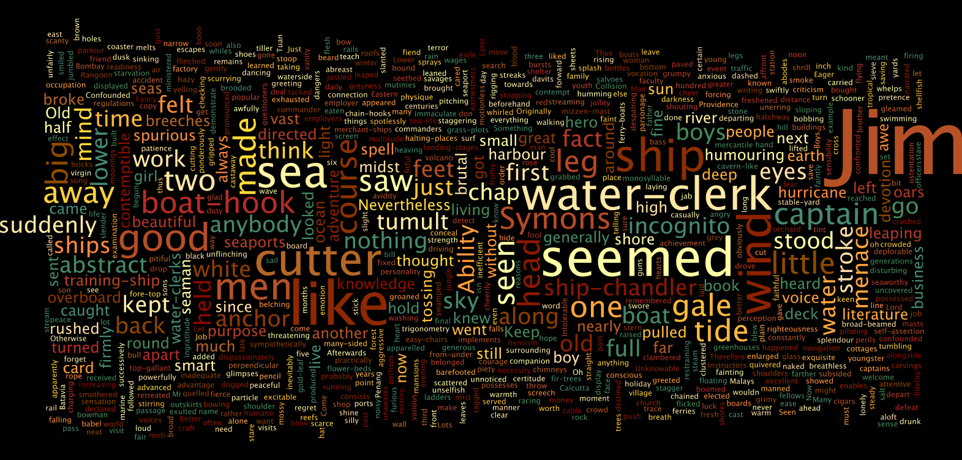

Slide 3
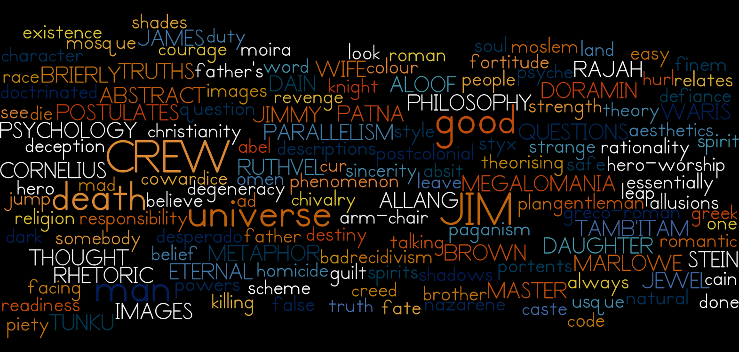

Slide 4
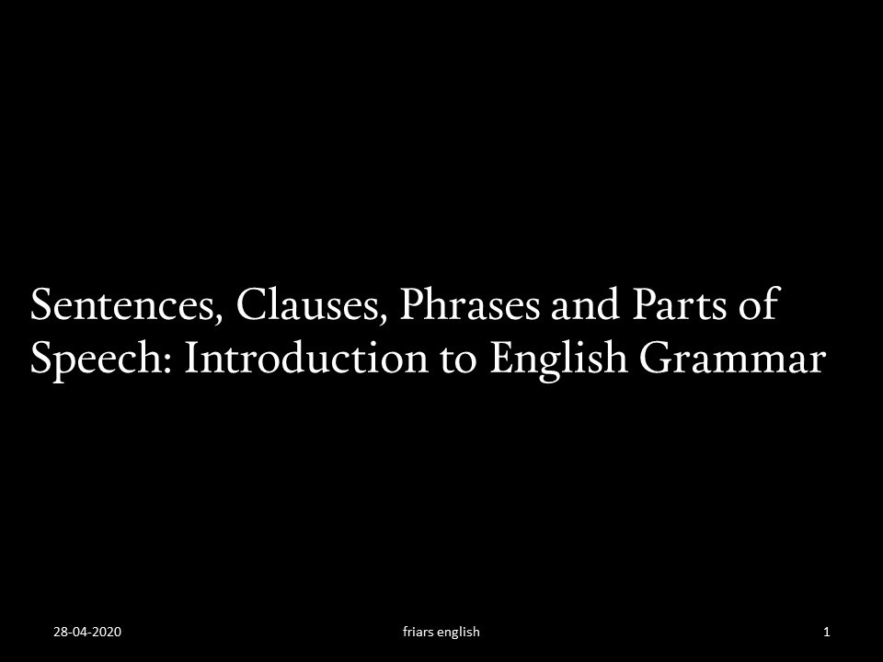

Slide 5
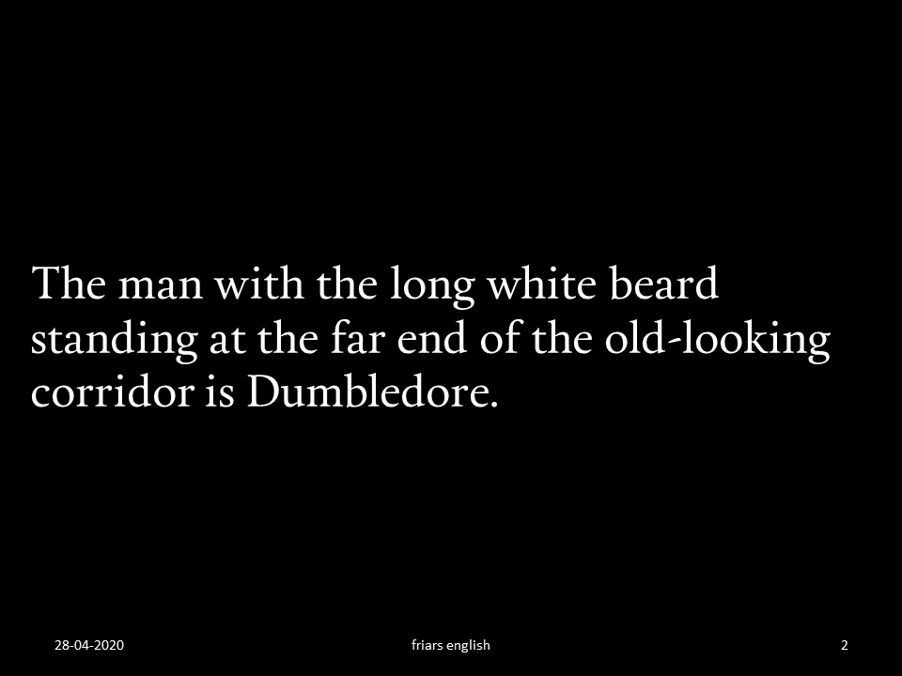

Slide 6
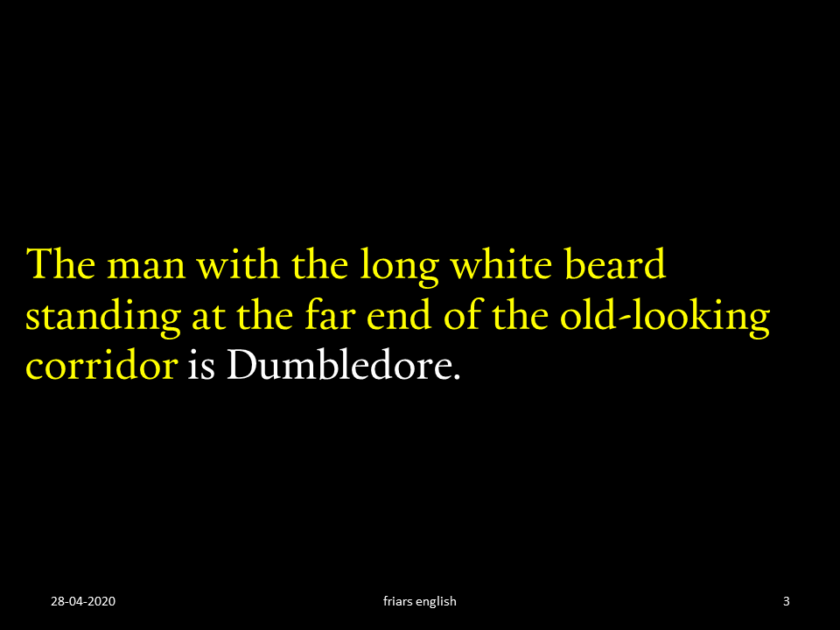

Slide 7
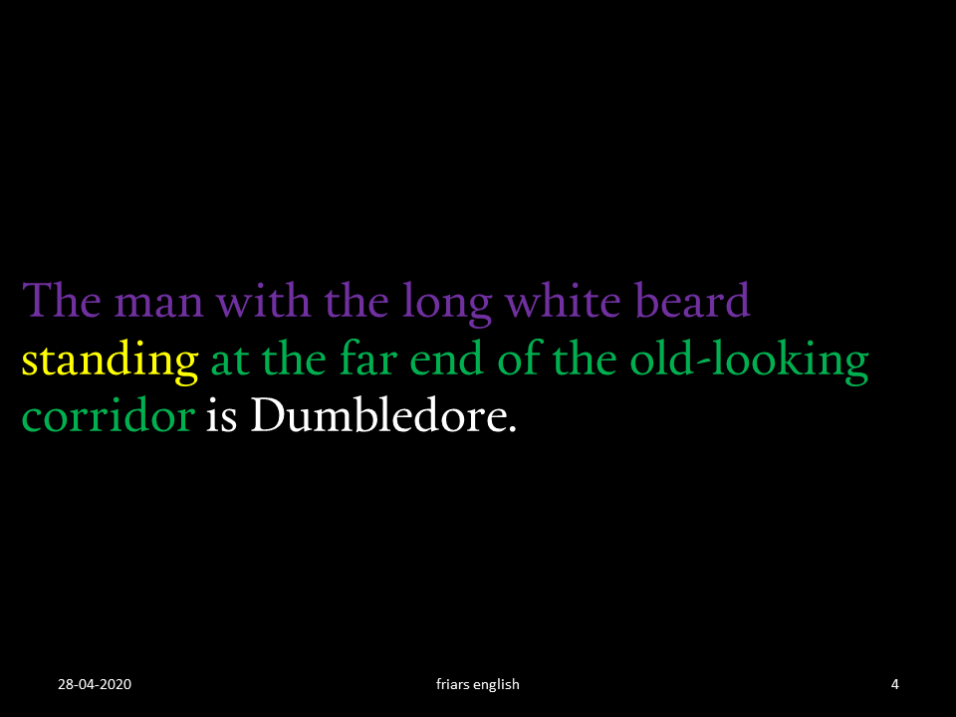

Slide 8
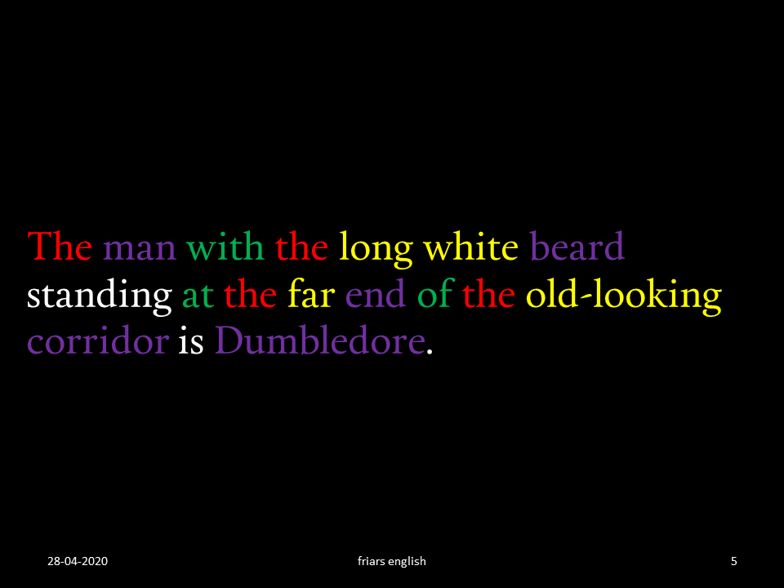

Slide 9
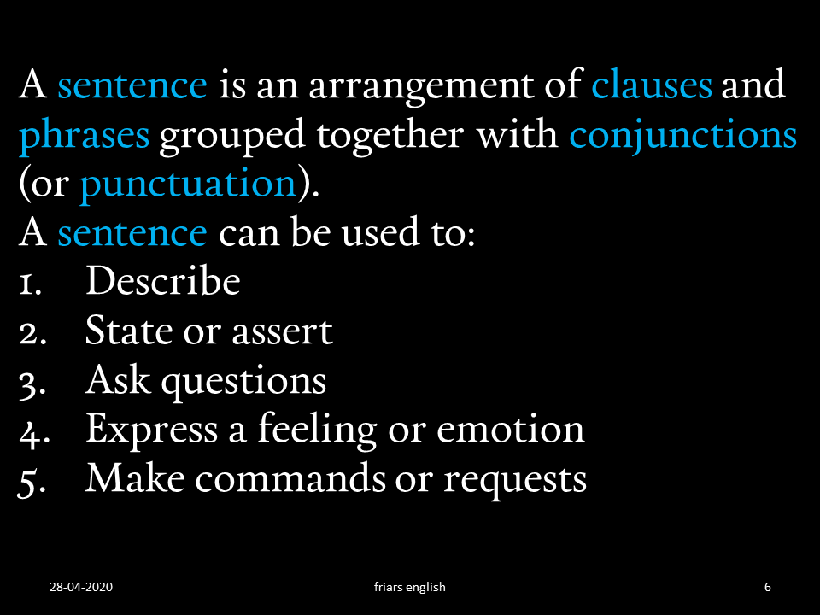

Slide 10
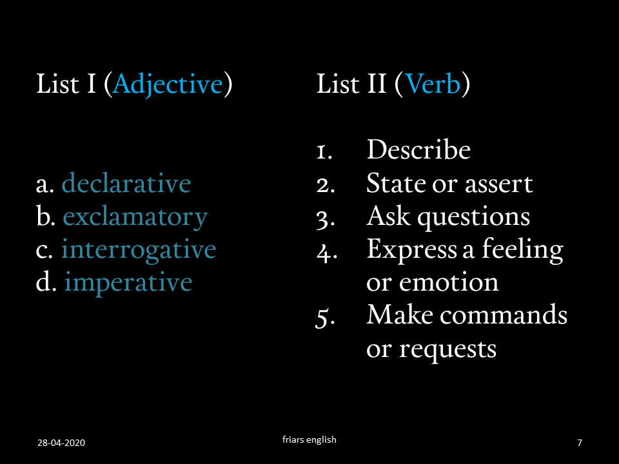

Slide 11
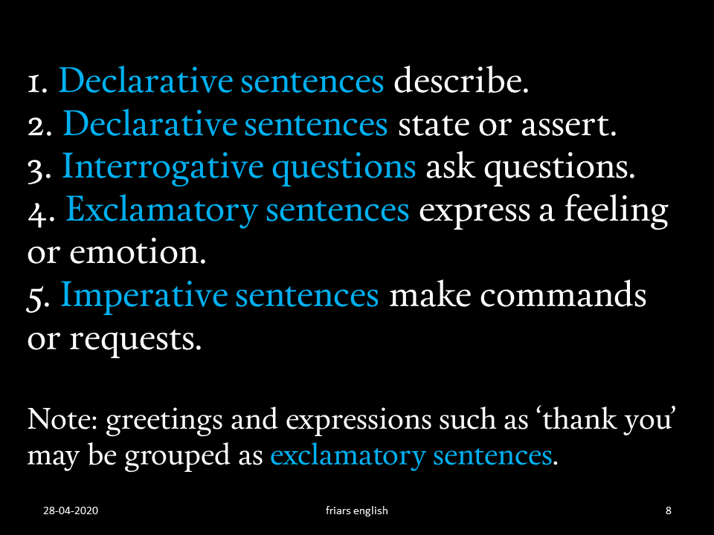

Slide 12
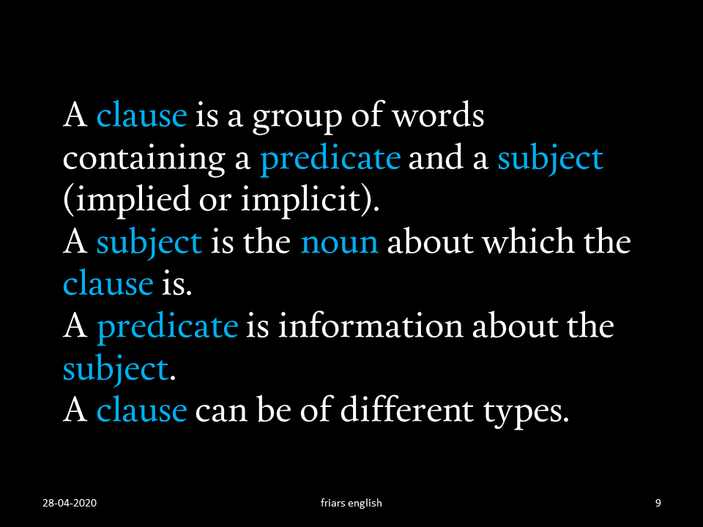

Slide 13


Slide 14
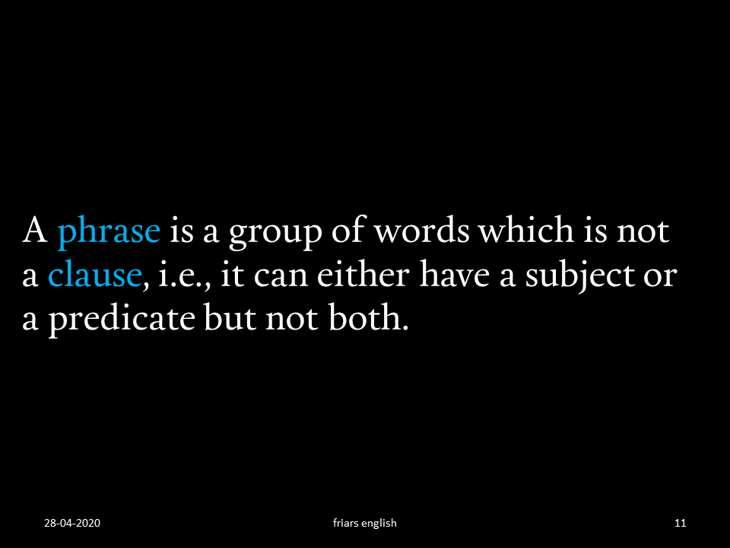

Slide 15
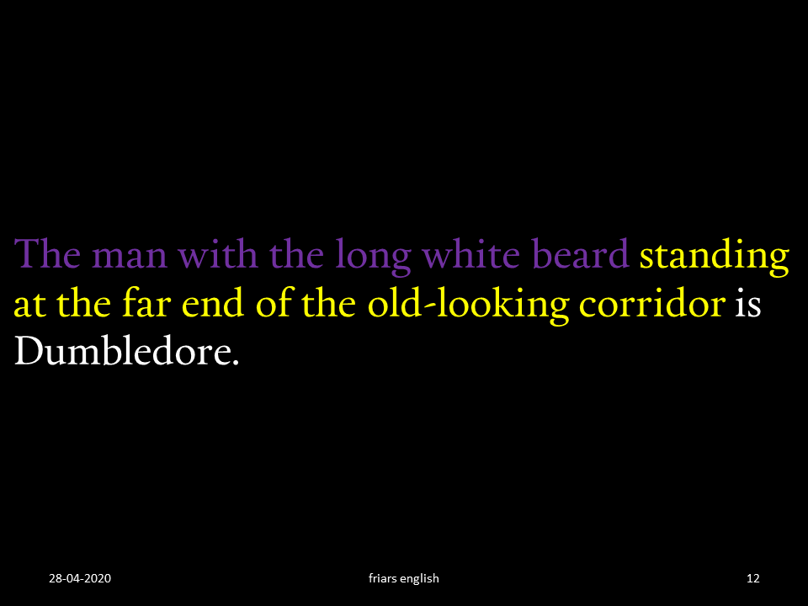

Slide 16
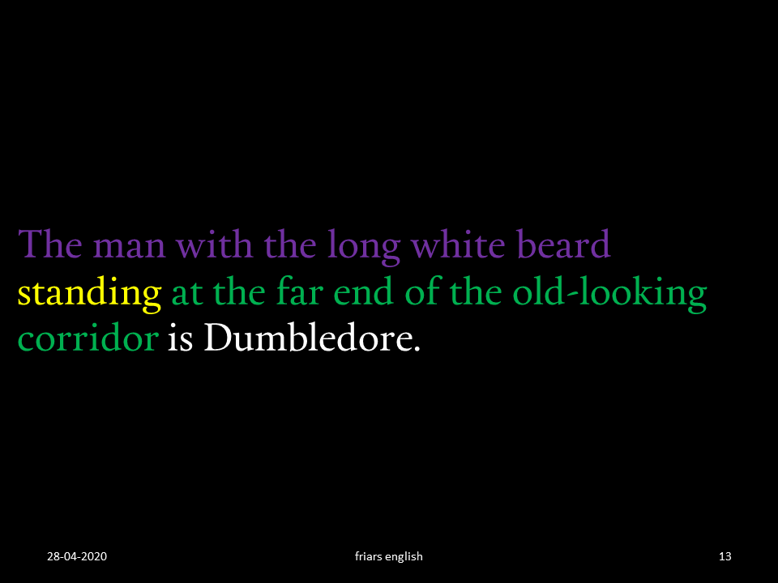

Slide 17
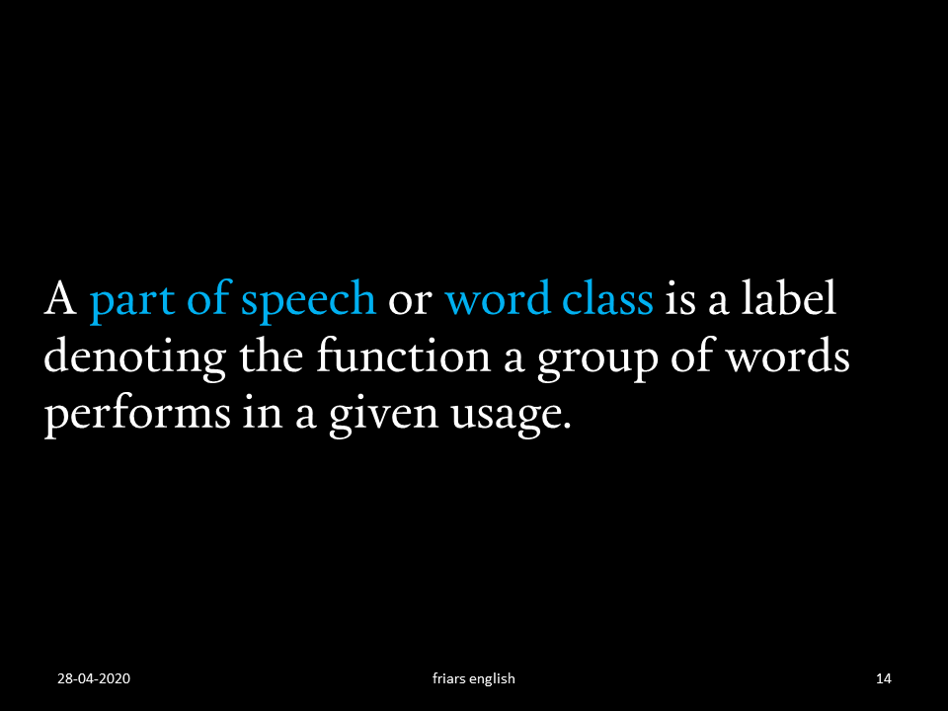

Slide 18
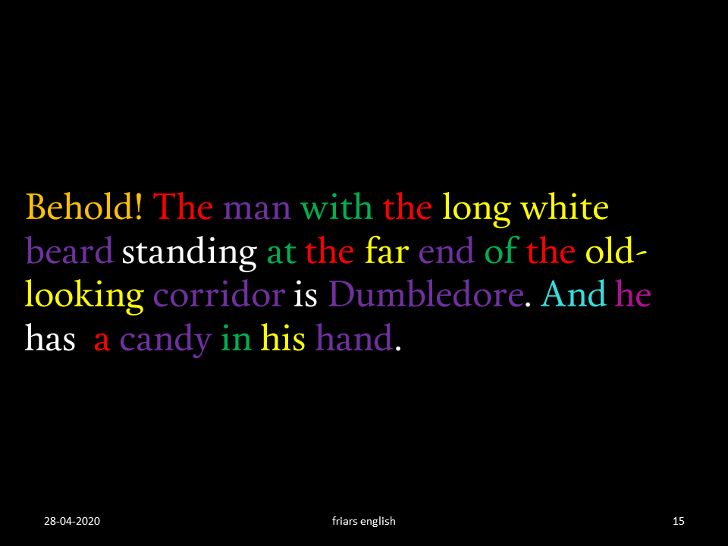

Slide 19
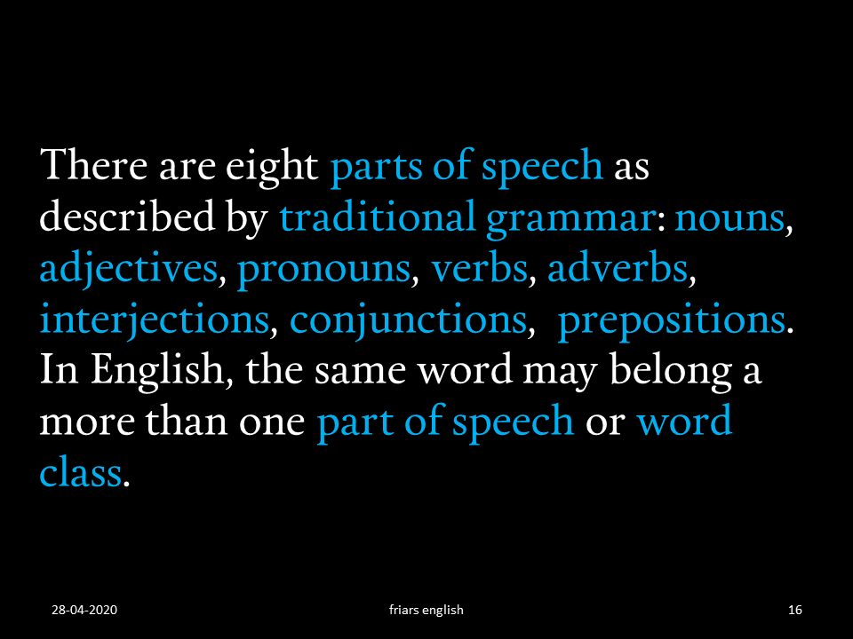

Slide 20


Slide 21
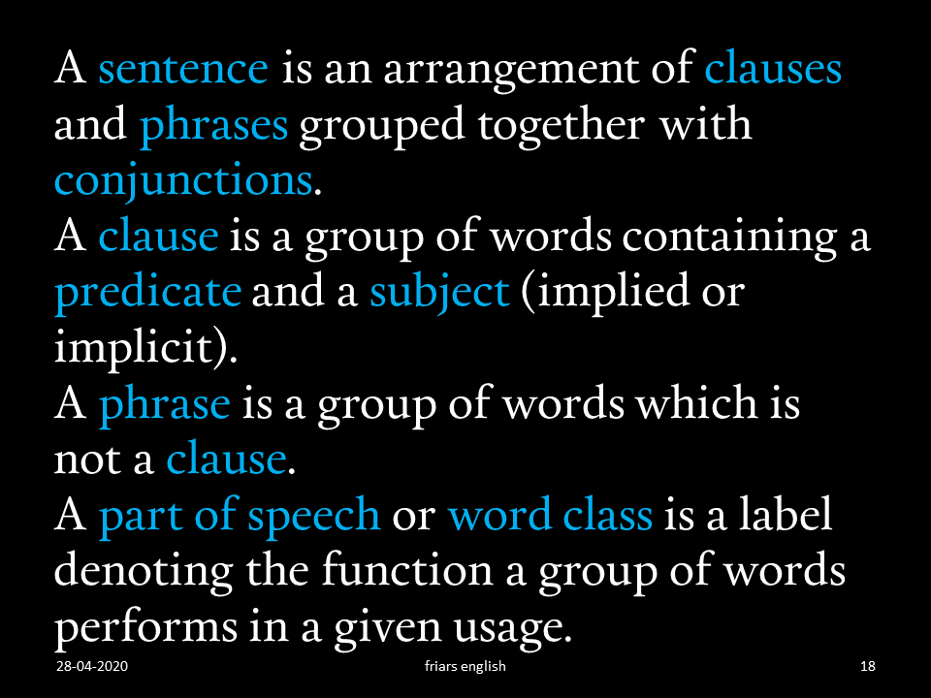

Slide 22
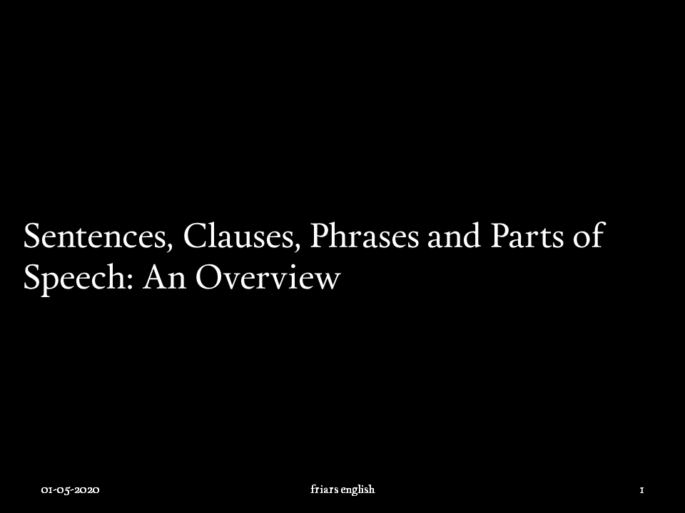

Slide 24
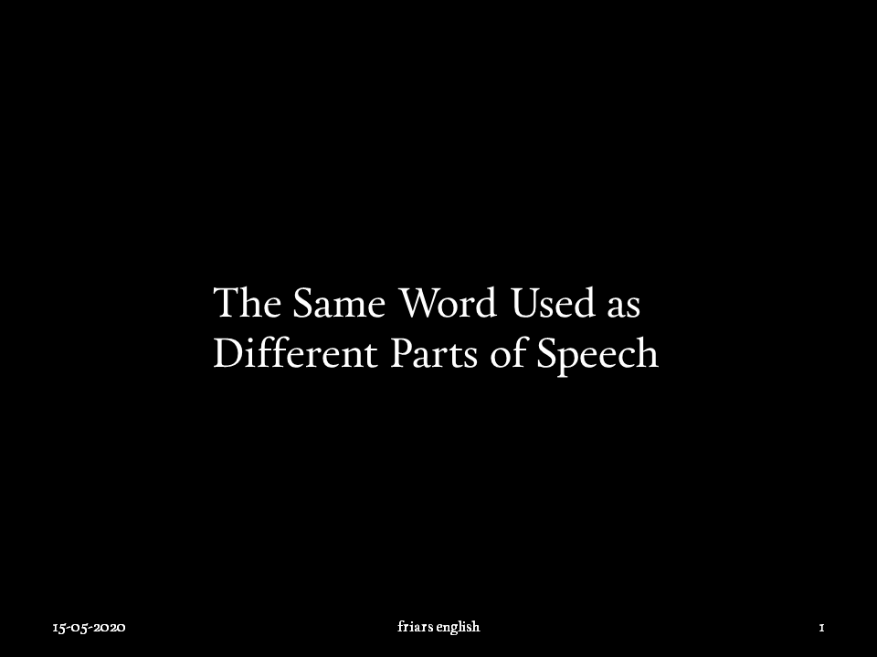

Slide 25
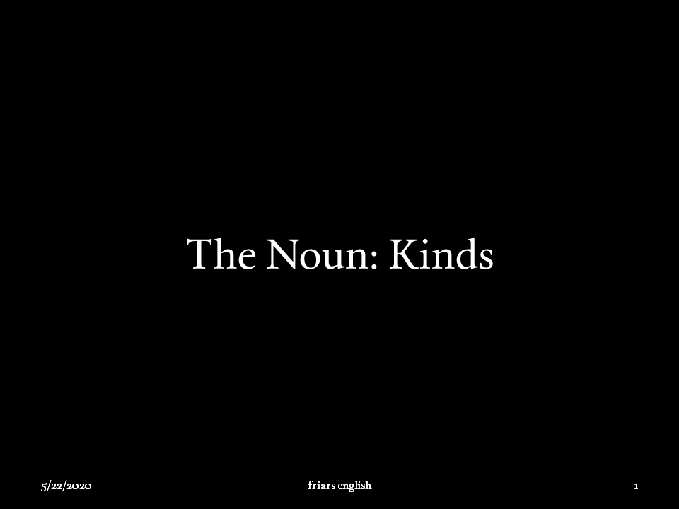

Slide 28
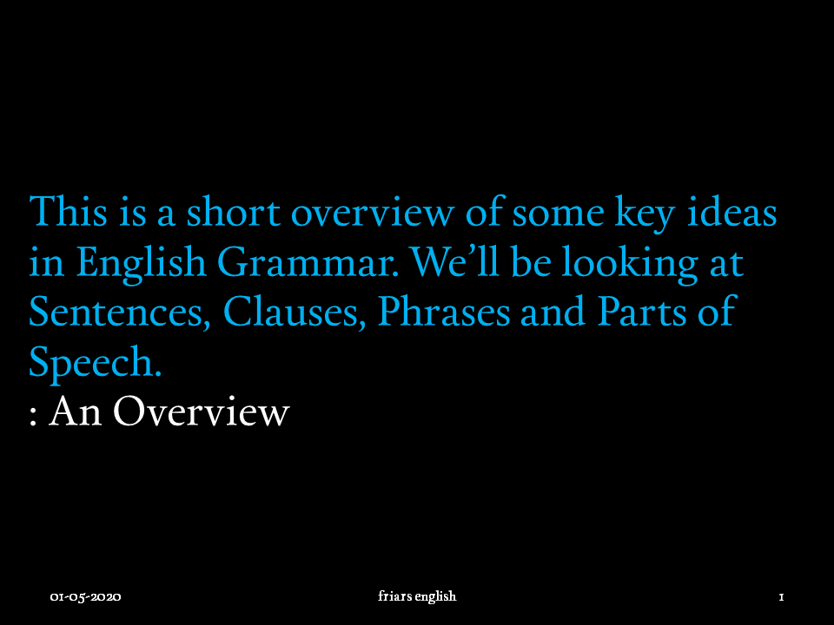

Slide 29
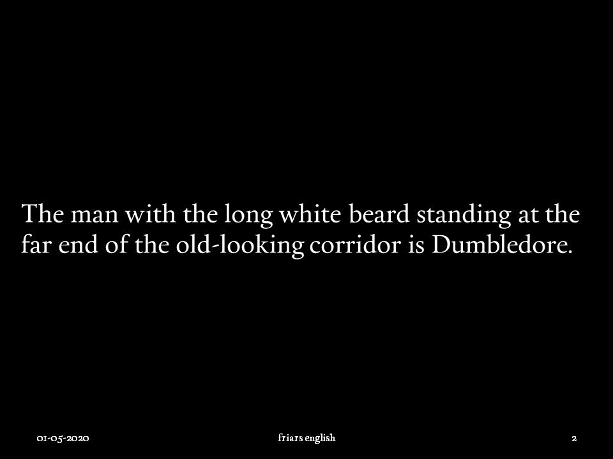

Slide 31
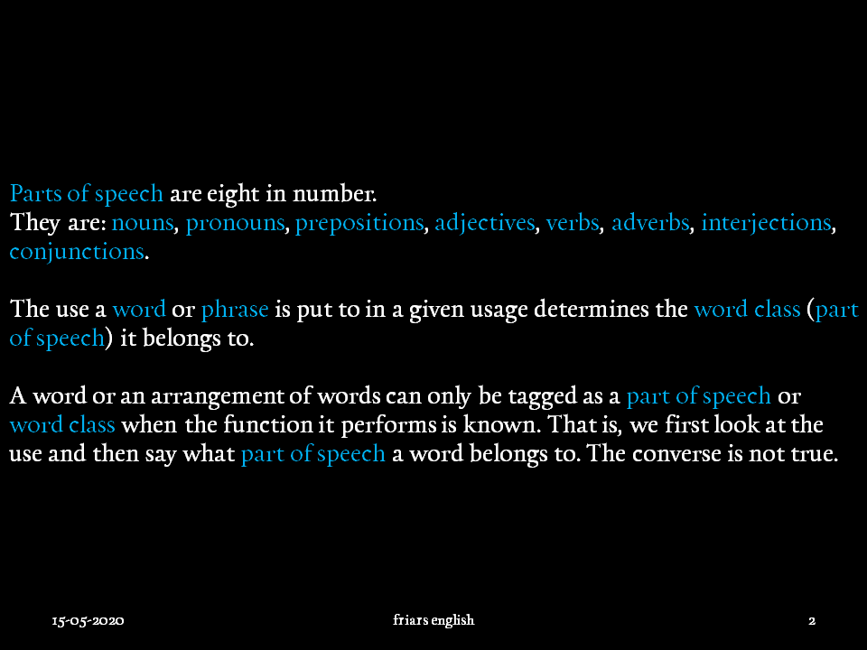

Slide 32
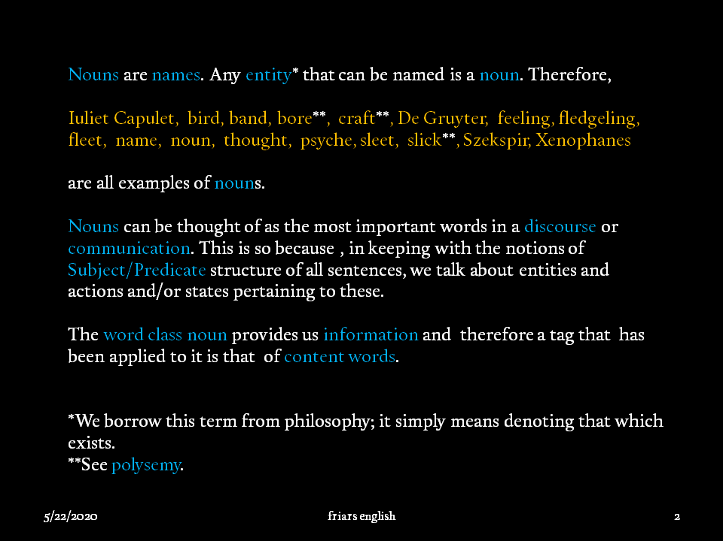

Slide 35
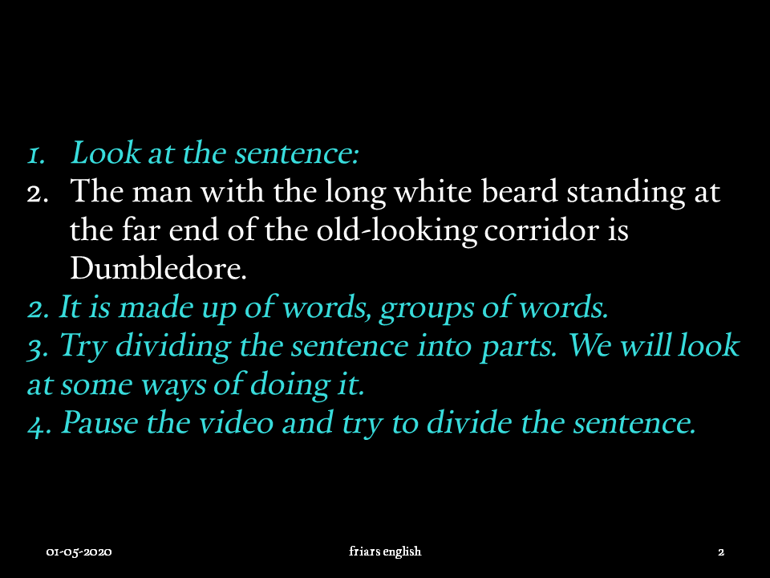

Slide 36
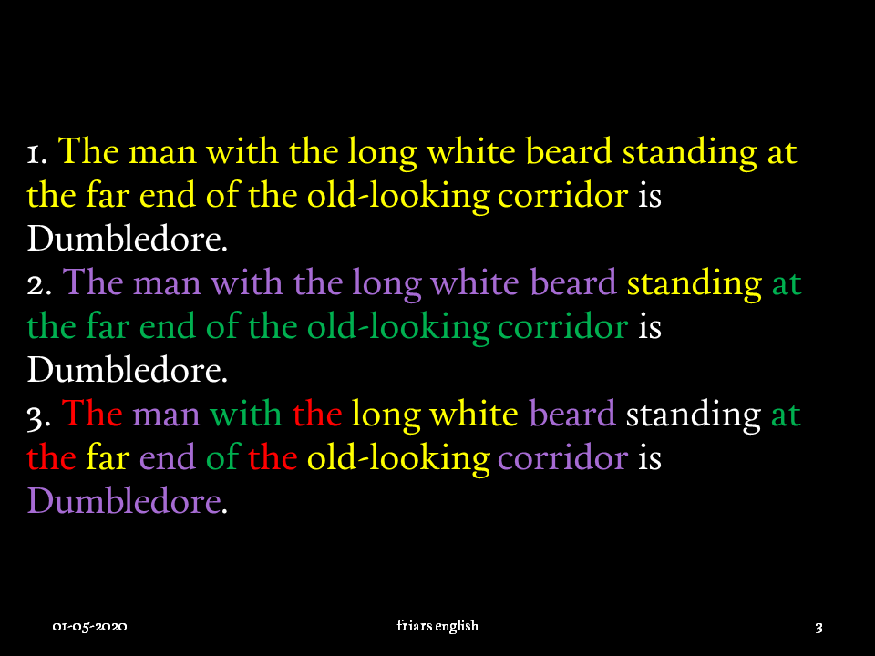

Slide 38
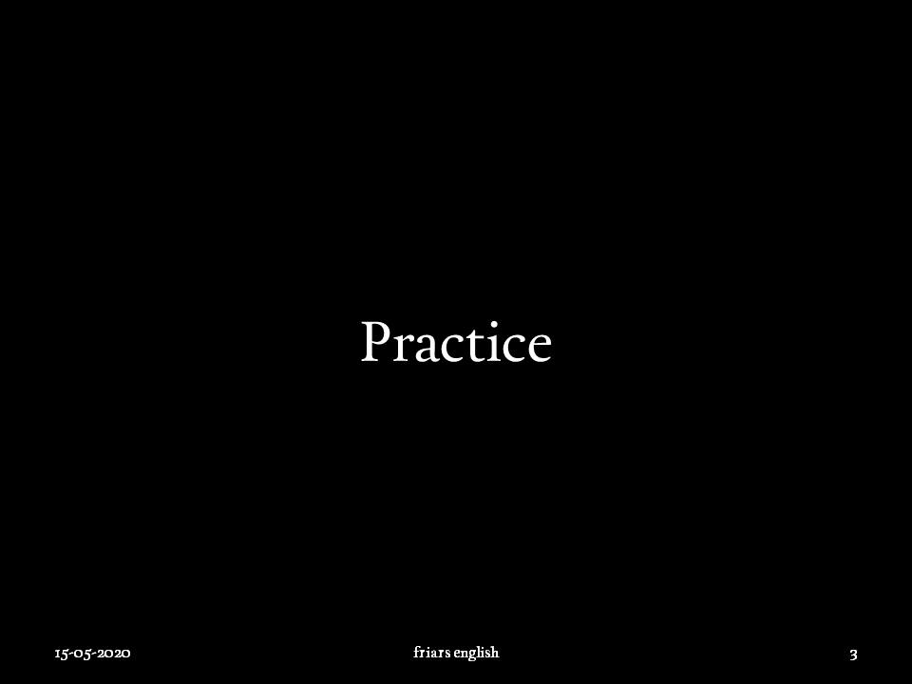

Slide 39
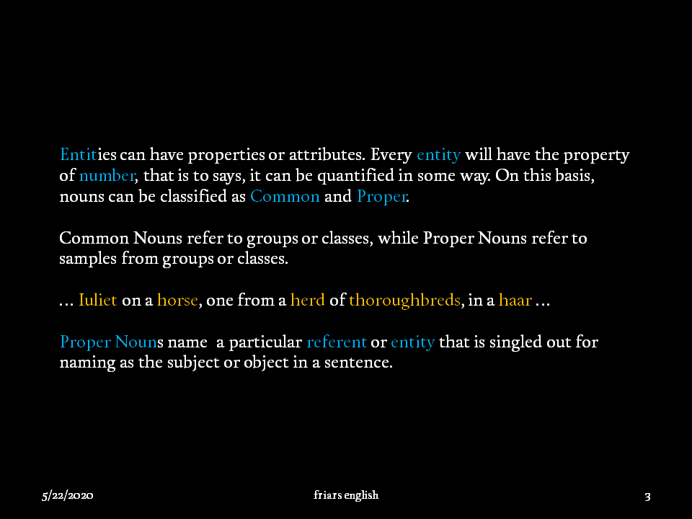

Slide 40
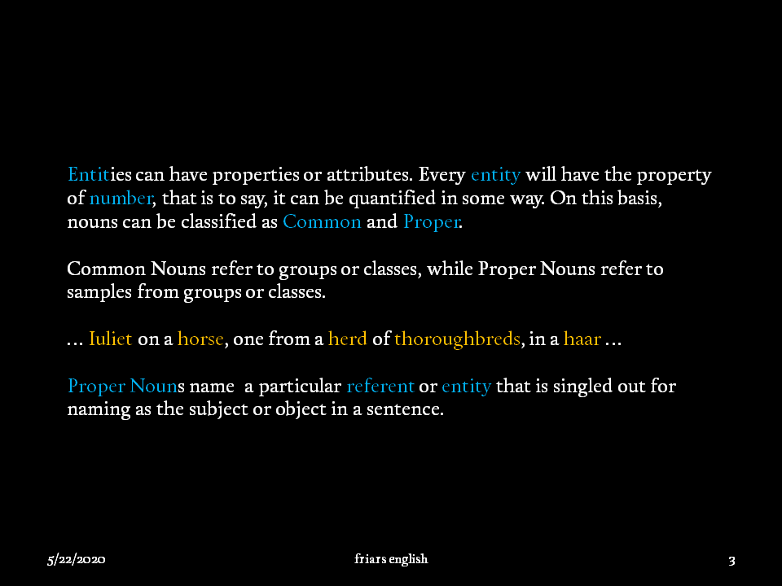

Slide 42
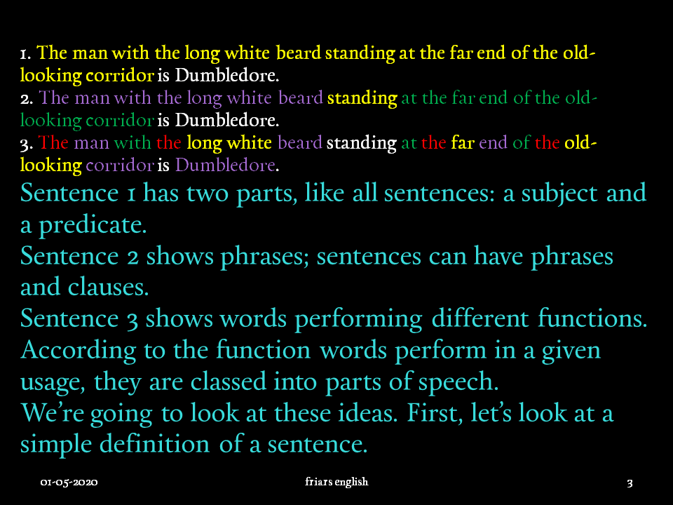

Slide 43
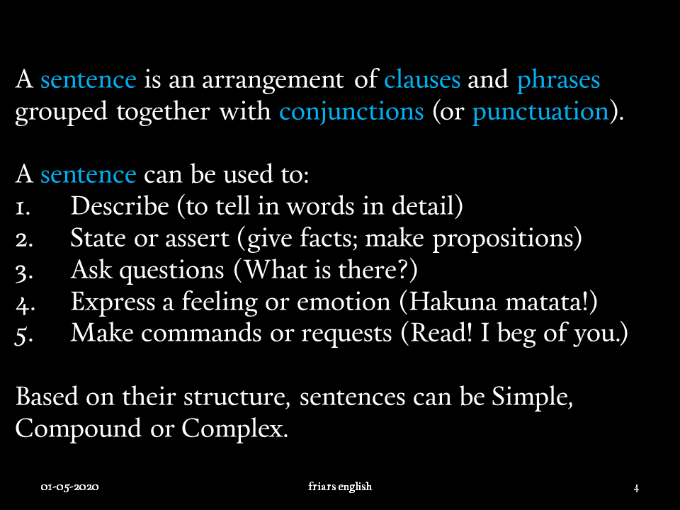

Slide 45
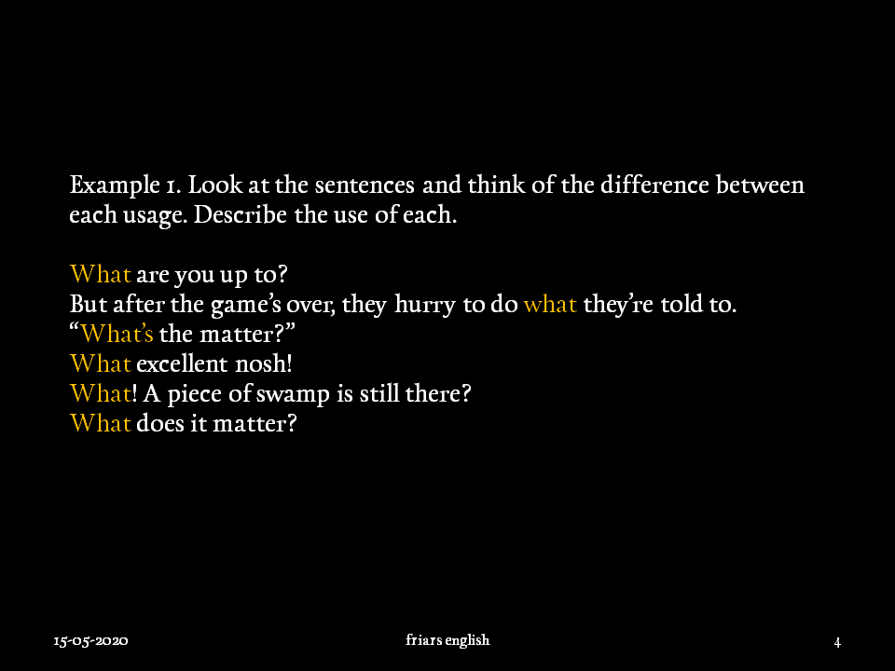

Slide 46
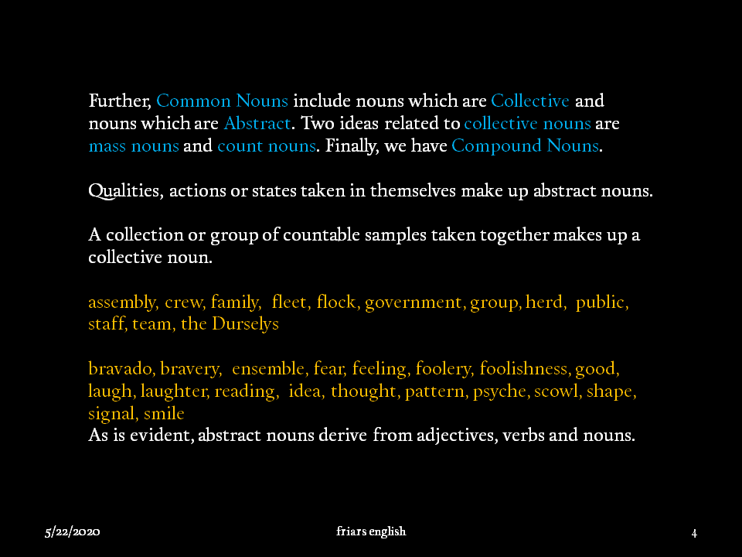

Slide 47
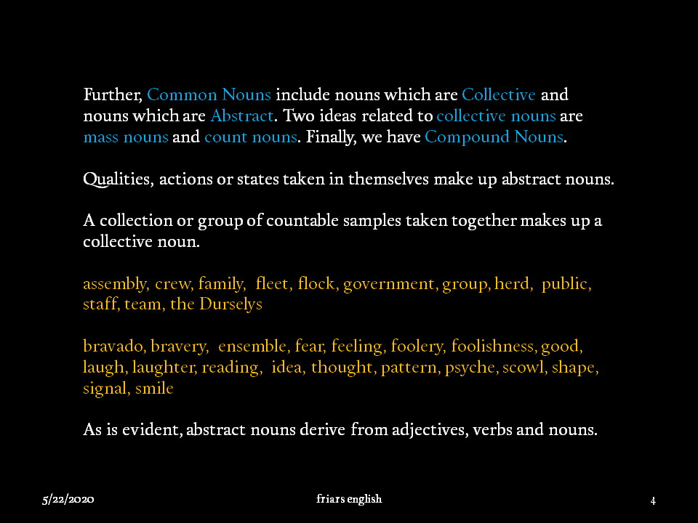

Slide 49
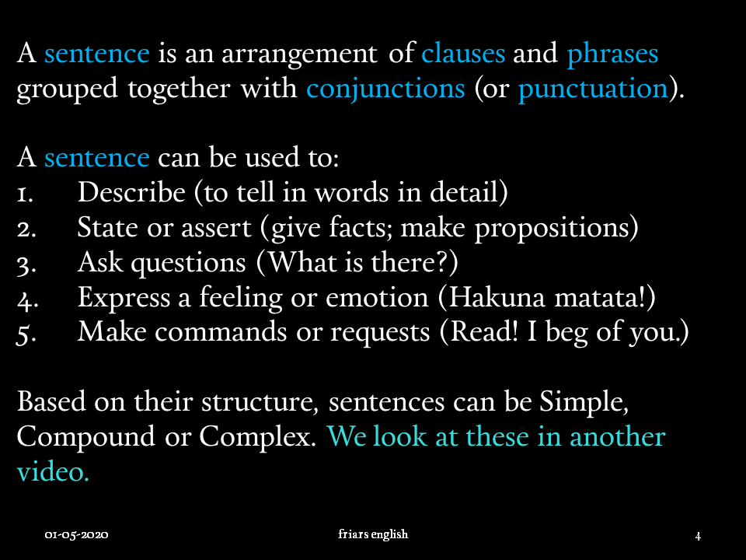

Slide 50
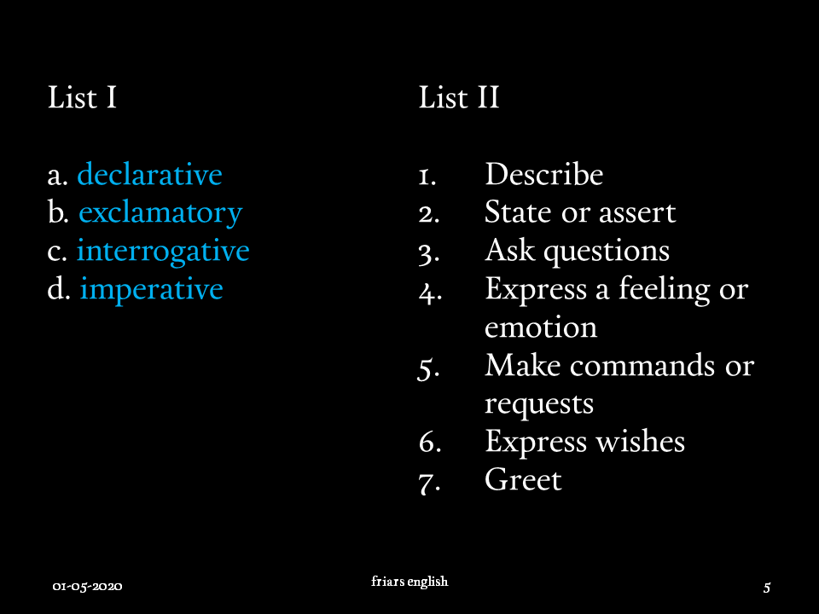

Slide 52
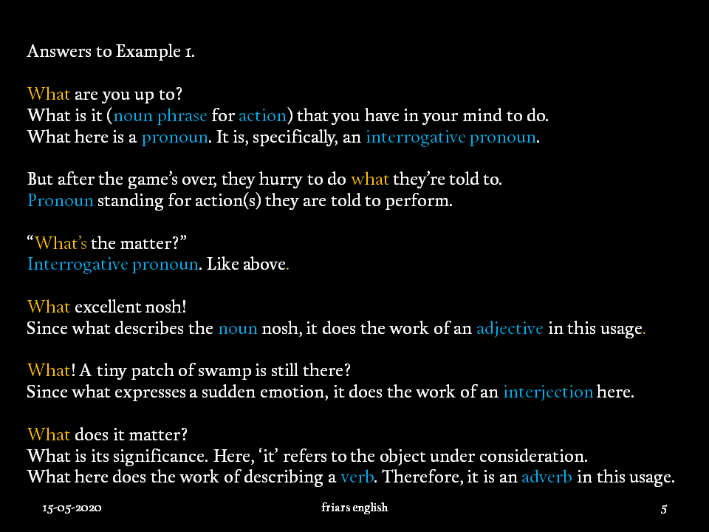

Slide 53
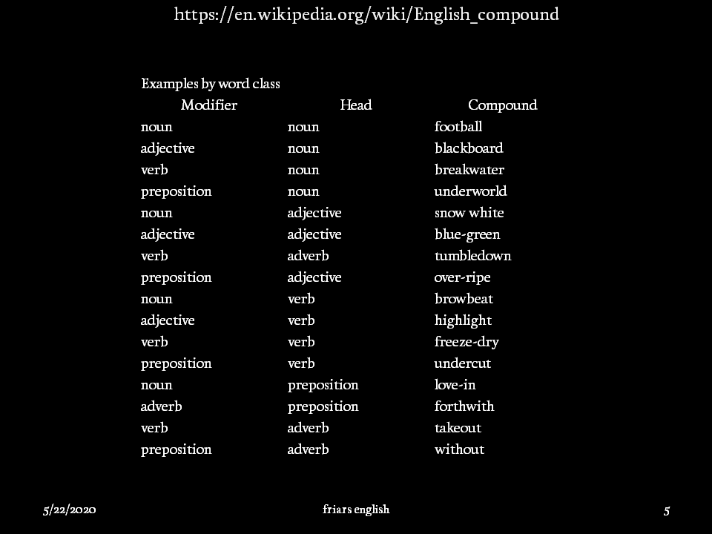

Slide 56
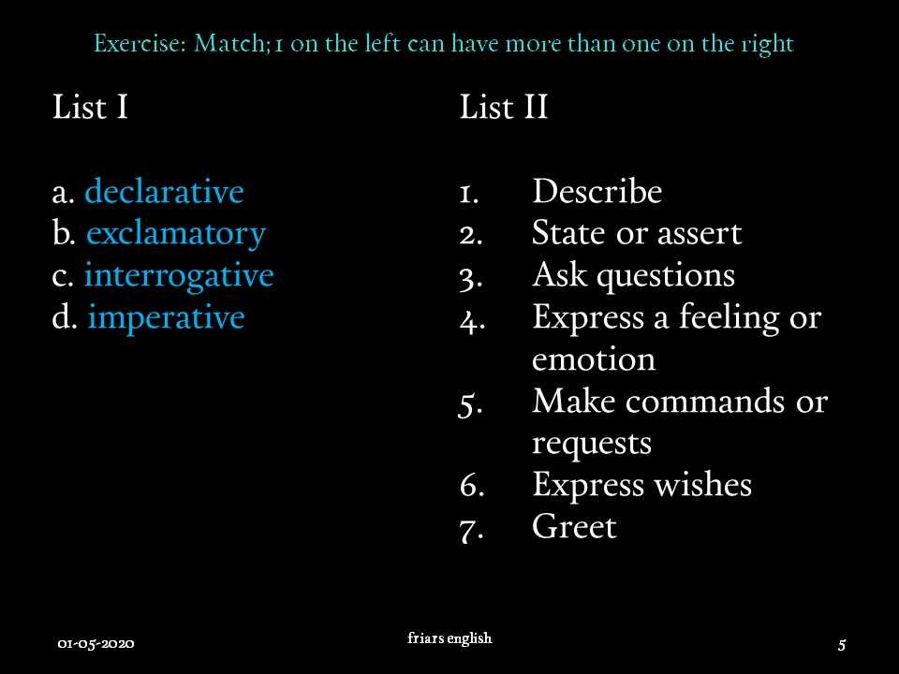

Slide 57
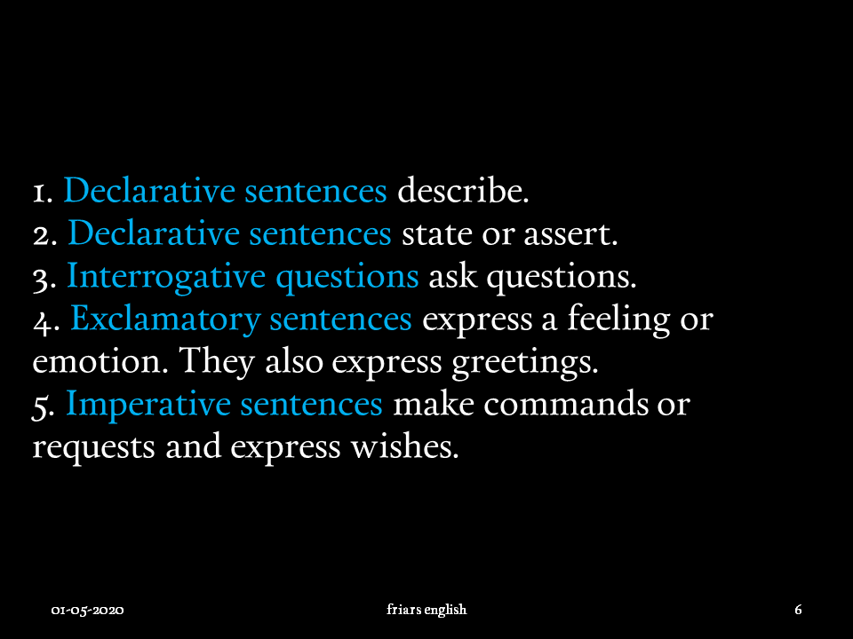

Slide 58
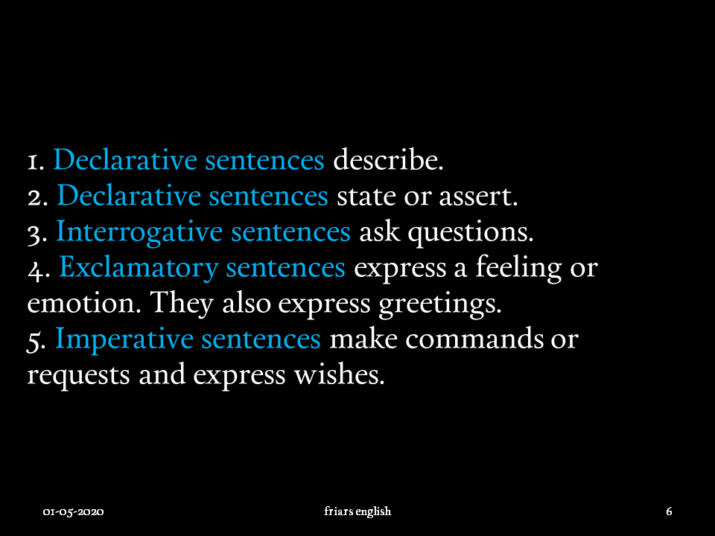

Slide 59
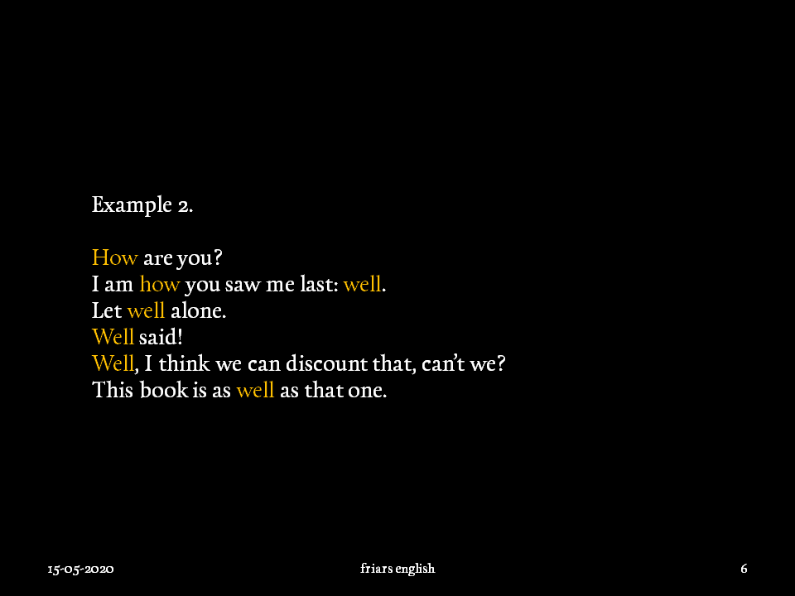

Slide 60
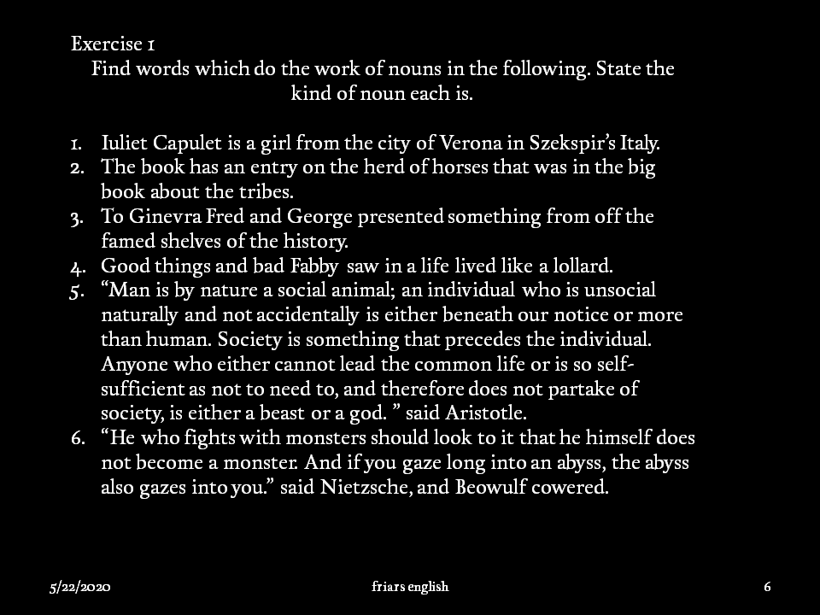

Slide 63
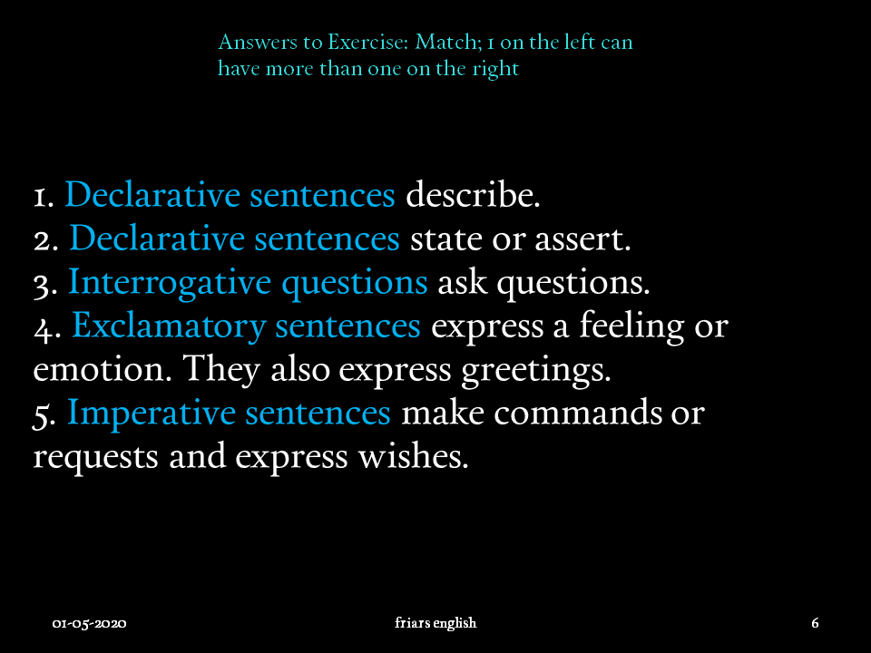

Slide 64
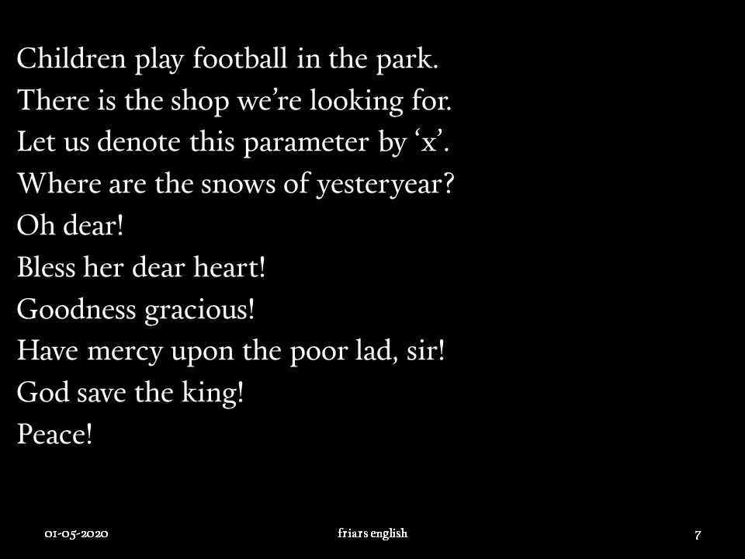

Slide 66
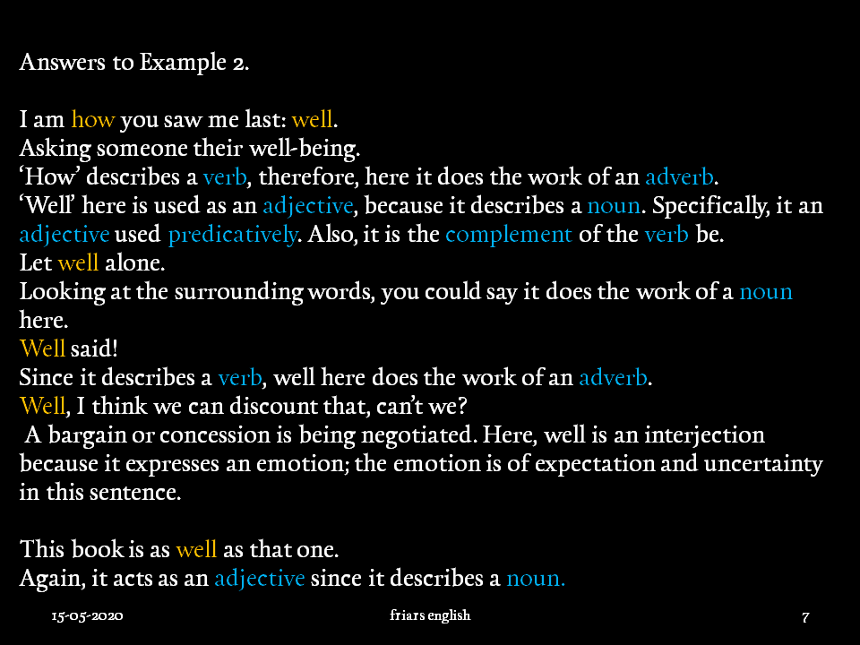

Slide 67
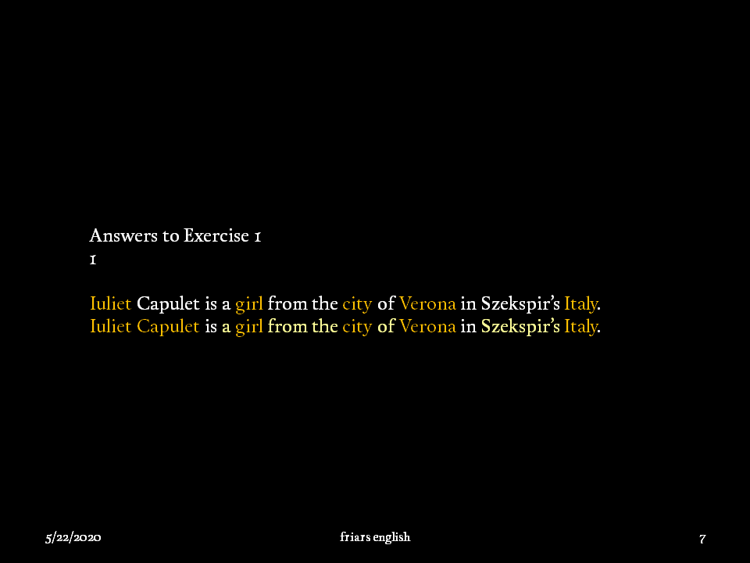

Slide 70
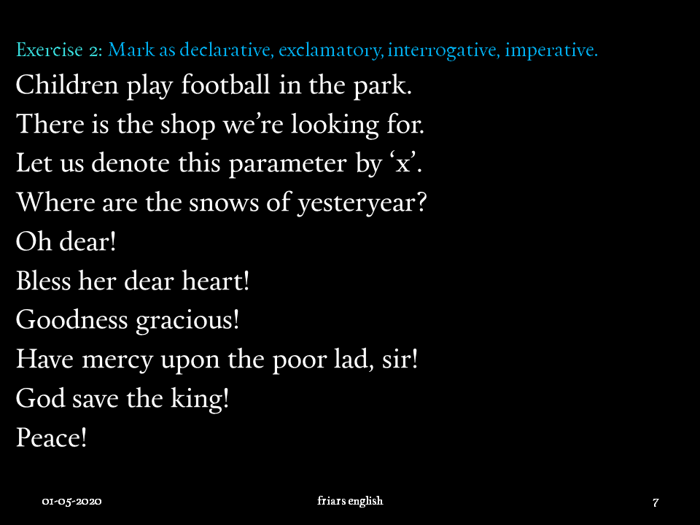

Slide 71
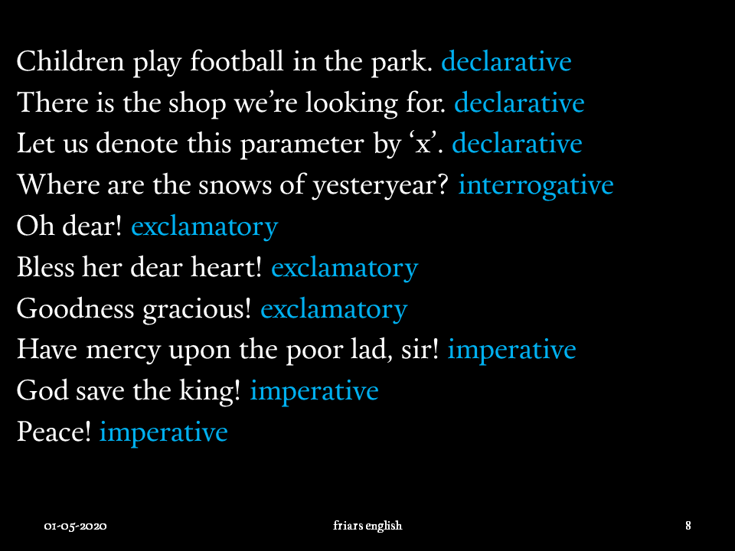

Slide 73


Slide 74


Slide 77


Slide 78


Slide 80


Slide 81


Slide 82


Slide 85


Slide 86


Slide 88


Slide 90


Slide 93


Slide 94


Slide 96


Slide 97


Slide 101


Slide 103


Slide 104


Slide 107


Slide 108


Slide 110


Slide 111


Slide 112


Slide 113


Slide 116


Slide 117


Slide 118


Slide 119


Slide 121


Slide 122


Slide 126


Slide 128


Slide 131


Slide 132


Slide 133


Slide 136


Slide 138


Slide 142


Slide 144


Slide 147


Slide 148


Slide 151


Slide 152


Slide 154


Slide 155


Slide 156


Slide 158


Slide 159


Slide 162


Slide 163


Slide 167


Slide 168


Slide 171


Slide 174


Slide 175


Slide 176


Slide 178


Slide 179


Slide 183


Slide 184


Slide 187


Slide 191


Slide 192


Slide 194


Slide 195


Slide 196


Slide 198


Slide 199


Slide 200


Slide 203


Slide 204


Slide 206


Slide 207


Slide 208


Slide 211


Slide 214


Slide 215


Slide 219


Slide 223


Slide 224


Slide 227


Slide 231


